Slide 1
Real-Time Order Book Aggregation & Optimal Trade Execution

Slide 2
System Design
Requirement Clarification
Back-of-the-envelope Estimation
System Interface Definition
Data Model Definition
High Level Design
Detailed Design
Identifying & Resolving Bottlenecks

Slide 3
1. Requirement Clarification
Functional Requirements
Real-time Order Book Fetching
Support 100 tokens & 180 trading pairs
Reload interval: 100 ms
Rate limit for usage of exchange API: 1000 requests/s
Stale duration: 3 mins
Efficient Order Book Processing
Optimal Trade Route Calculation
Multi-Hop Trading Support
Maximum 3 hops
REST API Endpoint

Slide 4
1. Requirement Clarification
Non-Functional Requirements
Low Latency
The system should provide near real-time responses for trade calculations
High Availability
The system should be resilient to API failures from exchanges
Scalability
The architecture should handle multiple exchanges and large trading volumes
Fault Tolerance
Ensure fallback mechanisms in case of API failures or data inconsistencies
Security
Secure API endpoints and prevent abuse (e.g., rate limiting)

Slide 5
2. Back-of-the-envelope Estimation
Expected DAU: 10 million
Read QPS – Queries per second:
Average: ~100
Peak: 500
Write QPS:
Order book data update: 10 x 180 = ~2000
Write payload:
Order book data ~ 100B x 2000 = ~200KB
Data storage:
Order book data history = 200 x 10^5 x 21 =~ 400GB

Slide 6
3. System Interface Definition
Subscribe order book (to exchange API)
Get trading pairs
Get order book
Get optimal trade route
Submit trade order (to exchange API)

Slide 7
3. System Interface Definition
Subscribe order book (to exchange API)
Only for Administrators
API:
POST /v1/admin/orderbooks/subscriptions
Request body:
“trading_pairs”
“depth”
“subscription_id”
“type” (subcribe/unsubscribe)
Header:
Authorization
Idempotency key

Slide 8
3. System Interface Definition
Get tokens
API: GET /v1/tokens

Slide 9
3. System Interface Definition
Get order book
API: GET /v1/orderbooks/{trading-pair}
Parameters:
Depth = 10 (integer)
Stale = false (bool)
Do not return stale order books (not updated for > 3 mins)

Slide 10
3. System Interface Definition
Get best trade route
API: GET /v1/trades/routes
Parameters:
Base_token (string)
Quote_token (string)
Amount (double)
Type = ask/bid (string)
Hops = 3 (integer)

Slide 11
3. System Interface Definition
Submit trade order (to exchange API)
API: POST /v1/trades/orders/
Request body:
“trade_route” (optional – referenced from previous API)
“trading_pair”
“amount”
“side” (buy/sell)
“order_id”
Header:
Authorization
Idempotency key

Slide 12
4. Data Model Definition
token |  |  |  | trading_pair |  |  |  | trade_order
id | INT | PK, Auto increment |  | id | INT | PK, Auto increment |  | id | INT | PK, Auto increment
symbol | VARCHAR | Unique |  | base_token | INT | FK |  | user_id | INT | FK
decimals | INT |  |  | quote_token | INT | FK |  | trading_pair | INT | FK
network | VARCHAR |  |  | exchange_id | INT | (optional, for extension) |  | price_ordered | DECIMAL
 |  |  |  |  |  |  |  | avg_price_filled | DECIMAL
 |  |  |  |  |  |  |  | amount_ordered | DECIMAL
order_book |  |  |  | subscription |  |  |  | amount_filled | DECIMAL
trading_pair | INT | FK |  | id | INT | PK, Auto increment |  | side | TINYINT | 0/1 : BUY/SELL
asks | JSON |  |  | pair_id | INT | FK |  | type | INT | 0/1/2… MARKET/LIMIT…
bids | JSON |  |  | exchange_id | INT | (optional, for extension) |  | status | INT
timestamp | DATETIME | 3.33 ms accuracy |  | active | TINYINT | 0/1 : boolean |  | created | DATETIME
 |  |  |  | created | DATETIME |  |  | updated | DATETIME
 |  |  |  | updated | DATETIME

Slide 13
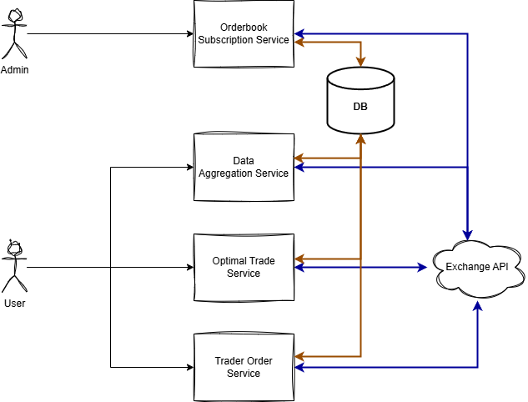
5. High Level Design

Slide 14
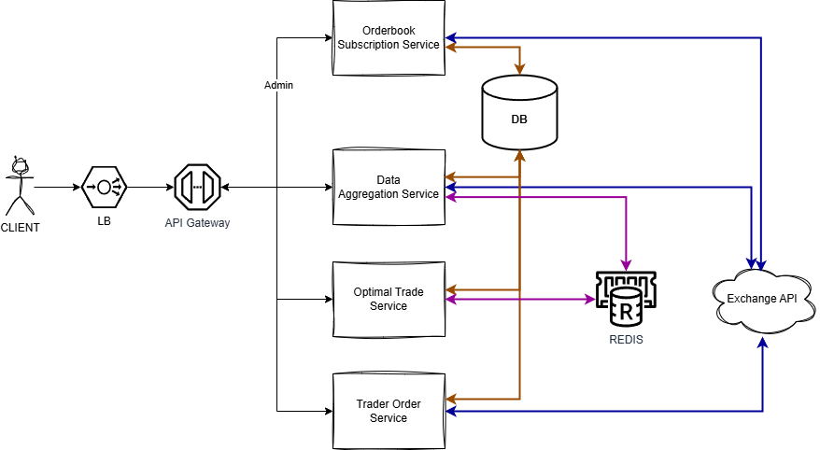
5. High Level Design

Slide 15
6. Detailed Design
DATA AGGREGATION SERVICE
Functionalities
Manage connection to Exchange API
Fetch token data & store to DB and Cache
Fetch order book data
Parse, validate & store order book data to DB and Cache
Respond to requests for data from Clients

Slide 16
6. Detailed Design
DATA AGGREGATION SERVICE
Modules
Websocket Connection Manager
Can be replaced with different connection protocols
Exchange Data Fetcher
Orderbook Data Processor
API Response Handler

Slide 17
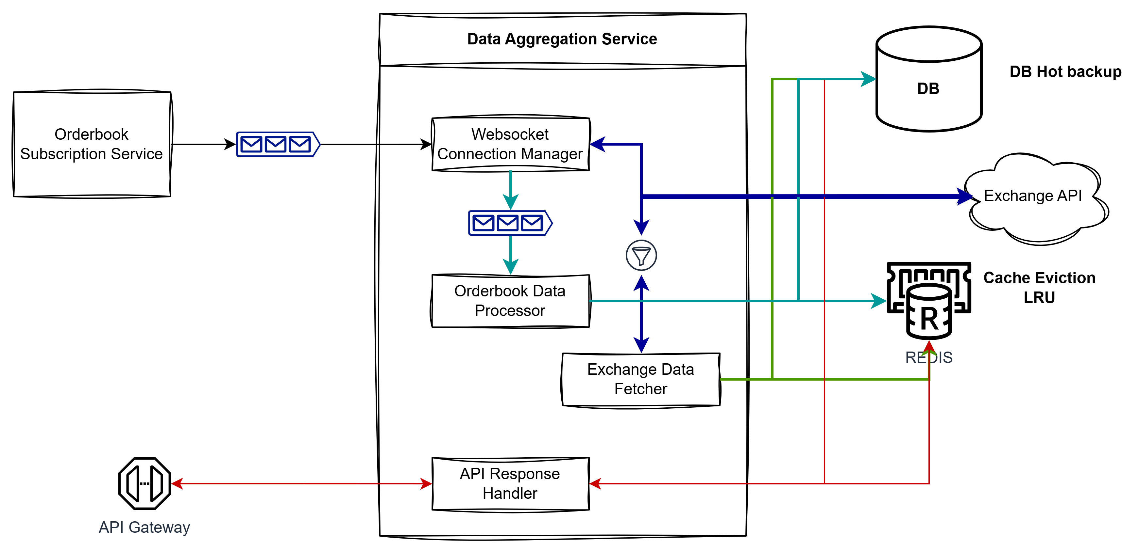
6. Detailed Design
DATA AGGREGATION SERVICE

Slide 18
6. Detailed Design
OPTIMAL TRADE SERVICE
Functionalities
Receive requests for best trade route from Clients
Read all necessary from Cache (or DB)
Tokens, Trading pairs
Order books
Run Shortest Path algorithm
Support Multi-hops
Store calculated route to Cache
Short TTL
Respond to Clients

Slide 19
6. Detailed Design
OPTIMAL TRADE SERVICE
Modules
API Response Handler
Trade Graph Builder
Path Finding Engine
Trade Data Manager

Slide 20
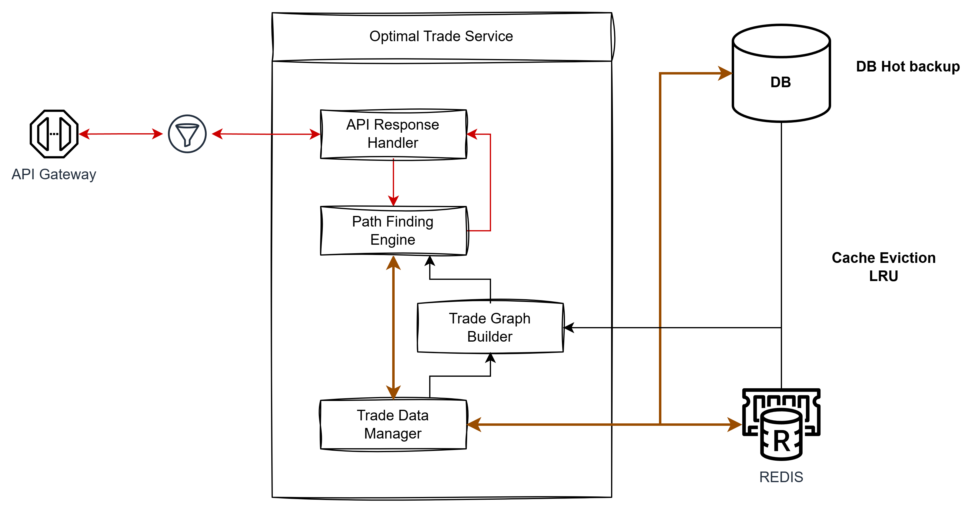
6. Detailed Design
OPTIMAL TRADE SERVICE

Slide 21
6. Detailed Design
TRADE ORDER SERVICE
Functionalities
Receive requests for ordering trades from Clients
Validate requests
If request contains “trade_route” (calculated optimal route), query route details from Cache
Send order request to exchange API
Store trade orders in DB and update order status
Handle errors received from exchange

Slide 22
6. Detailed Design
TRADE ORDER SERVICE
Modules
API Response Handler
Order Validator
Order Requester
Order Canceller
Order State Manager

Slide 23
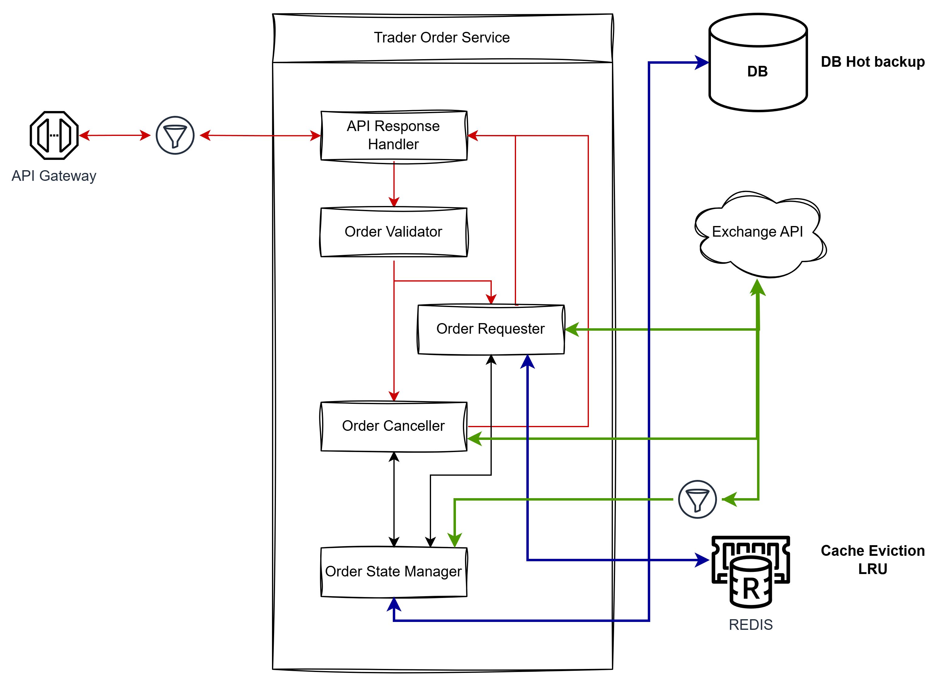
6. Detailed Design
TRADE ORDER SERVICE

Slide 24
7. Identifying & Resolving Bottlenecks

Slide 25

Thank you
Thanh Nguyen
ndthanh2605@gmail.com

